Slide 1
Analyzing the performance of a classification model

Slide 2
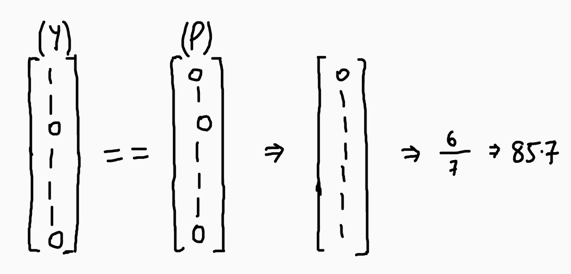
Accuracy
Model score for classification models calculates accuracy of prediction

Slide 3
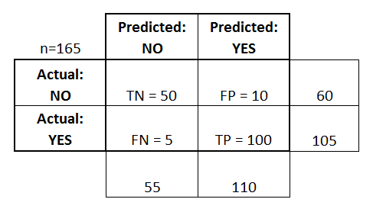
Confusion Matrix

Slide 4
Confusion Matrix
True Positive(TP) is when we predict a data point to be 'Yes' and it's actually 'Yes'
True Negative(TN) is when we predict a data point to be 'No' and its actually 'No' .
False Positive(FP) is when we predict a data point to be 'Yes' but it's actually 'No'.
False Negative(FN) is when we predict a data point to be 'No' but it's actually 'Yes' .

Slide 5
Accuracy using Confusion Matrix
Accuracy = TP + TN/(TP + TN + FP + FN)
maximize the number of True positives and True negatives and minimize the number of false positives and false negatives

Slide 6

False positive vs False negative
Predicting a person doesn’t have a disease when they do have it
Leads to huge loss (False negative)

Slide 7
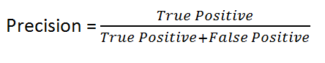
Precision
How much percentage of our predicted ‘yes’ are actually ‘yes’.
Precision is a good measure to determine when the costs of False Positive is high.

Slide 8
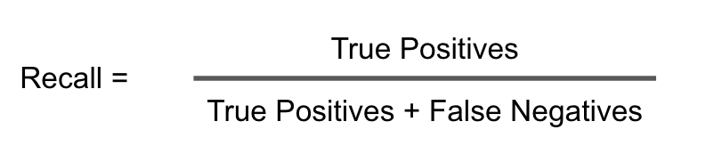
Recall
How much percentage of total labeled 'yes' are actually predicted 'yes'.
Recall is a good measure to determine when the cost of False Negative is high.

